Slide 1
Review of Prerequisites by Topics

Slide 2
Regular Expression
λ empty string
a one a
a+ one or more a’s
a* zero or more a’s
a | b a or b
ab a followed by b
[a] means a | λ
{a} means a*
Not particularly used, but some concepts (or similar notation) will be used in EBNF syntax description

Slide 3
Context-Free Grammar (CFG)
For programming language syntax description
Example 1
G1: E -> E + E | E * E | ( E ) | num | id
Example 2
G2: E -> E + T | T
T -> T * F | F
F -> ( E ) | num | id
Example 3
G3: S -> i(E)S | i(E)SeS | a
E -> b

Slide 4
Accepting Strings
Is the following string syntactically correct according to G1?
G1: E -> E + E | E * E | ( E ) | num | id
num * (id + id )
num * id (id + id)

Slide 5
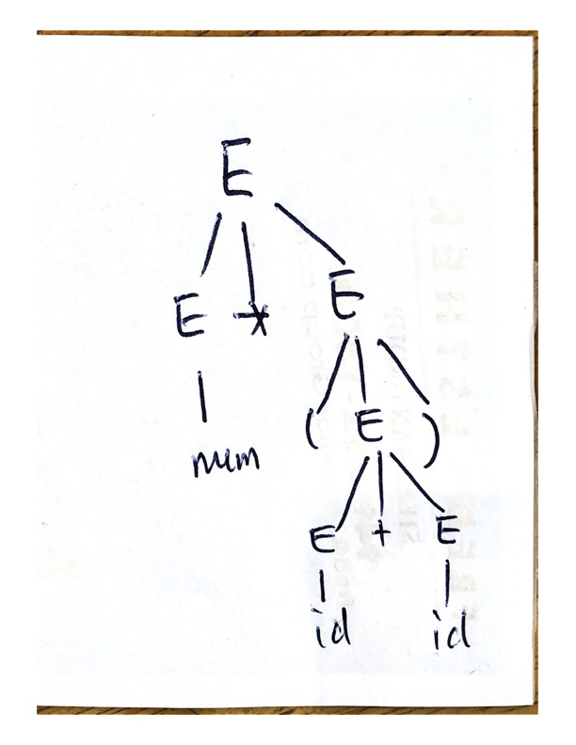
Accepting Strings
Are the following syntactically correct?
According to G1:
num * (id + id )
accepted: see parse tree
num * id (id + id)
rejected:
failed to create a parse tree

Slide 6
Real-World Example of CFG Java Statements (simplified version)
Statement: Block ; StatementExpression ; if ParExpression Statement [else Statement] switch ParExpression { SwitchBlockStatementGroups } while ParExpression Statement do Statement while ParExpression ; for ( ForControl ) Statement break [Identifier] ; continue [Identifier] ; return [Expression] ; throw Expression ; try Block (Catches | [Catches] Finally)

Slide 7
Expression: Expression1 [AssignmentOperator Expression1] AssignmentOperator: = += -= *= /= &= |= ^= %= <<= >>= >>>= Expression1: Literal [Expression1Rest] Expression1Rest: { InfixOp Expression1 }
InfixOp: || && | ^ & == != < > <= >= << >> >>> + - * / %
Literal: IntegerLiteral FloatingPointLiteral CharacterLiteral StringLiteral BooleanLiteral NullLiteral

Slide 8
Ambiguous Grammars
Is G1 ambiguous?
What about G2? G3?
Example 1
G1: E -> E + E | E * E | (E) | num | id
Example 2
G2: E -> E + T | T
T -> T * F | F
F -> ( E ) | num | id
Example 3
G3: S -> i(E) S | i(E)SeS | a
E -> b

Slide 9
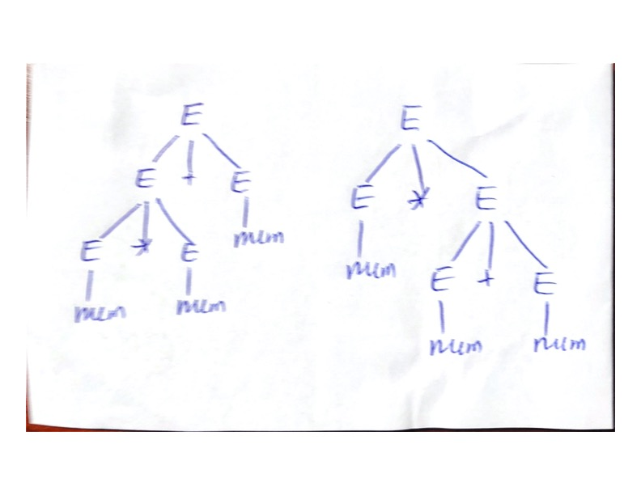
Prove a CFG is ambiguous
G1: E -> E + E | E * E | (E) | num | id
Find a string, num * num + num
Create two distinct parse trees, both accepting the string

Slide 10
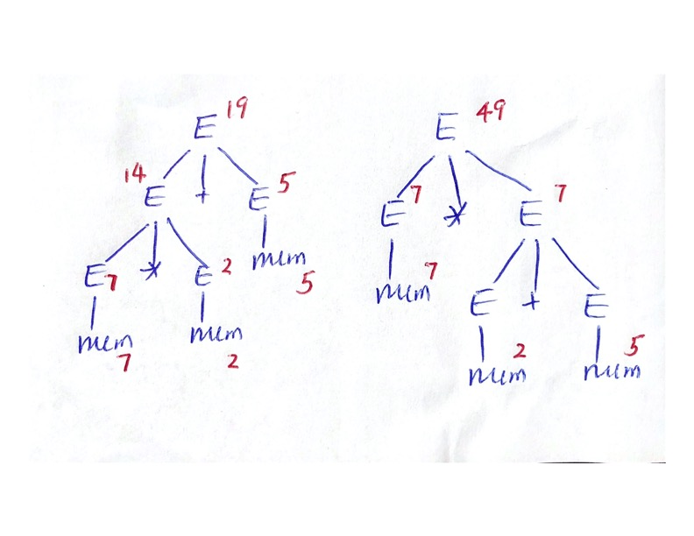
What’s wrong with ambiguous grammar?
Multiple meaning, e.g.
7 * 2 + 5
Could be interpreted as
(7*2)+5 = 19
Or
7*(2+5) = 49

Slide 11
How to avoid ambiguity? – Common Strategies
Rewrite the grammar into equivalent but unambiguous grammar, e.g.
G1: E -> E + E | E * E | (E) | num | id
G2: E -> E + T | T
T -> T * F | F
F -> ( E ) | num | id
G1 and G2 are equivalent (proof omitted), but G2 unambiguous
G2 unambiguous: can you prove it?

Slide 12
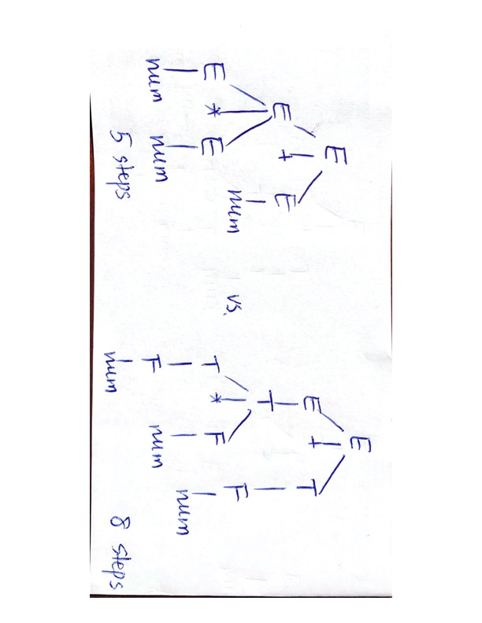
G2 vs. G1: Pros and Cons
G2 unambiguous
no confusion, unique meaning for a given input string
Takes more steps for G2 to accept a string

Slide 13
Common Strategies
2. Enforcing semantic meanings
e.g. operator precedence
left side tree:
* is higher than +
right side tree:
+ is higher than *
One of them trees will be eliminated
depending on the definition of operator precedence

Slide 14
Case Study
G3: S -> i(E)S | i(E)SeS | a
E -> b
G3’: Stmt -> if ( Expr ) Stmt | if ( Expr ) Stmt else Stmt
String: if (a < b)
if (c < d) {
System.out.println(“Hi”);
}
else {
System.out.println(“Bye”);
}

Slide 15
Which one is right interpretation? i.e. which if should the else match?
if (a < b)
if (c < d) {
System.out.println(“Hi”);
}
else {
System.out.println(“Bye”);
}
if (a < b)
if (c < d) {
System.out.println(“Hi”);
}
else {
System.out.println(“Bye”);
}
#note: { } unnecessary in this case

Slide 16
Different interpretation different semantic meaning
b1
b1
F
T
F
T
F
b2
b2
T
F
T
“Bye”
“Hi”
“Bye”
“Hi”

Slide 17
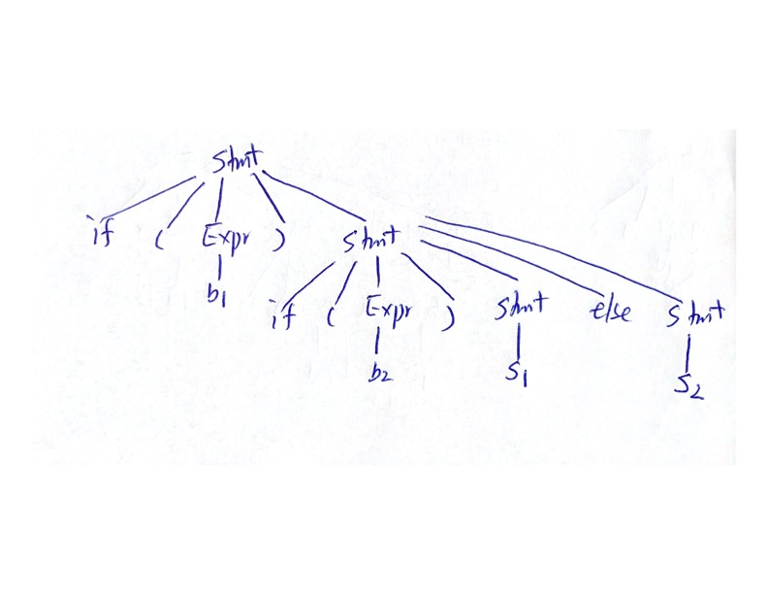
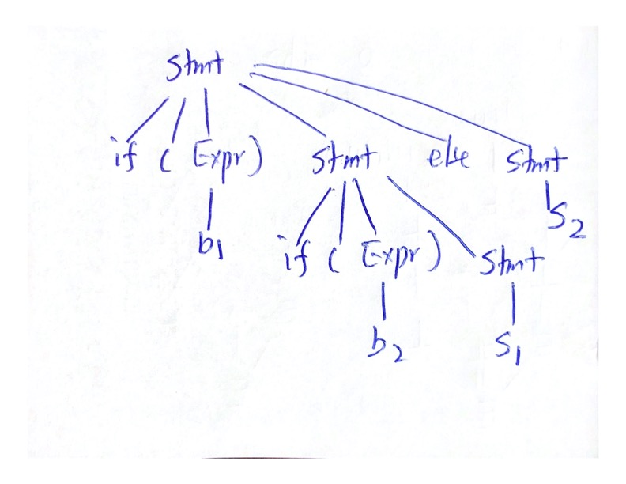
Parse/Derivation Tree Representation

Slide 18
Resolving Ambiguity for “dangling else”
(simplify to) if (b1) if (b2) S1 else S2
Rewrite to unambiguous CFG
next slide
2. Semantic rule
“else” matches the closest “if”

Slide 19
Ambiguous vs. Unambiguous Grammar
Ambiguous
IfStatement :
if ( Expression ) Statement
if (Expression) Statement else Statement
Oracle:
IfThenStatement: if ( Expression ) Statement IfThenElseStatement: if ( Expression ) StatementNoShortIf else Statement IfThenElseStatementNoShortIf: if ( Expression ) StatementNoShortIf else StatementNoShortIf
here: StatementNoShortIf refers to any statement without an ifThenStatement in it. The syntax definition for StatementNoShortIf is omitted here.

Slide 20
Unambiguous grammar – another solution
G3’: Stmt -> MS | US #MS: matched statement
#US: unmatched statement
MS -> if ( E ) MS else MS | a
US -> if ( E ) S | if ( E ) MS else US
E -> b

Slide 21
Practice
Use unambiguous grammar for if statement to build up a parse tree for the string if (b1) if (b2) a1 else a2

Slide 22
Practice
Study the grammar of your language
Expressions
ambiguous or unambiguous grammar?
operator precedence rules?
sample accepting strings, non accepting strings
Statements: assignment, if, while, …
ambiguous grammar or not?
sample accepting strings, non accepting strings

Slide 23
Pseudo Assembly Language
a = b #move instruction
a = b op c #e.g. a = b * c, a multiplication instruction
Note: a = b * c + b not appropriate, no corresponding instruction
goto Label #jump instruction
if a relop b goto Label #conditional branching instruction
#e.g. beq, bne, bgt, bge, ble, blt, …
Label: #statement can have label

Slide 24
Translating to low-level instructions
Make sure same meaning
For classwork, do not optimize
Example
total = 1
for (j=0; j < n; j++)
total = total + j * 5
total = 1
j=0
Loop:
if j >= n goto Exit
t = j * 5
total = total + t
j = j + 1
goto Loop
Exit:

Slide 25
Practice
while (j++ < n) {
total = total + j * 2
n = n / 2
}
…print(“Done”)
switch (n) {
case 1: …print(“A”);
case 2: … print(“B”);
break;
case 3: … print(“C”);
break;
default: … print(”D”);
}

Slide 26
Practice
Translate each of the following to low-level code and compare the semantic meaning
if (a < b)
if (c < d)
a = a + b;
else c = c – d;
if (a < b) {
if (c < d)
a = a + b;
}
else c = c – d;

Slide 27
Activity
Team to study your language
Study syntax definition
Starting with simple expressions, assignments, …
Making up codes, some with no syntax errors, some with syntax errors

